Slide 1
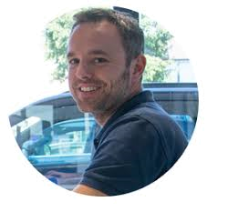
Manufacturing Knowledge Sharing
Supplier presentation Bax Metaal B.V.
Presenter:
Mathijs Kox
Function:
Sales Director
Notes:
FACILITATOR GUIDANCE:
Time: 5 min before the session + 2 minutes.
11:02 – 11:04
Remark: Be mindful about your starting time during the session. Wait not longer than 2 minutes.
Supporting speaking notes/pointers:
Hello all participants.
Welcome to the first digital manufacturing Live meeting.
A new approach for these presentation sessions.
A happening where you can learn, listen and participate actively.
Be patient with us when some things are not perfect.
Today sheet metal is on the agenda as a manufacturing process.

Slide 2
Today’s Experts and Facilitator
Collaboration to increase knowledge in manufacturing processes
Mathijs Kox Sales Director Bax Metaal Presenter
Arno Sprengers Manufacturing Knowledge Competence Facilitator
Notes:
FACILITATOR GUIDANCE:
Time: 2 minutes
11:04 – 11:06
Remark: be brief and relevant
Arno:
Mathijs Kox from Bax metal will explain the further details of this process.
Mathijs can you introduce yourself?
Mathijs:
Introducing him selves.

Slide 3
Agenda
Supplier conversation Bax metaal B.V.
Welcome and expectations
Why using sheet metal?
What are the core processes?
Which challenges do you see?
Brake
How can we cooperate to innovate?
Closing & next steps
19 min
20 min
10 min
5 min
10 min
14 min
2 min
Notes:
FACILITATOR GUIDANCE:
Time: 3 minutes
11:06 – 11:09
Remark:
Supporting speaking notes/pointers: Welcome the participants and run them through the purpose and agenda of the coming 2 hours.
Arno:
We have put together the following agenda for you.

Slide 4
Setup for today
You will be actively participating in the conversation section and exercises
Ask questions and share your thoughts via the conversation section
Describe your own facial expressions via emojis, Gifs or MEME’s ☺
Keep your phone at hand to participate in our polls and quizzes
How to actively participate
We will record the session for further reference
We will ask you to post your challenges for the supplier before the break, so feel free to note them down during the session
Notes:
FACILITATOR GUIDANCE:
Time: 2 minutes
11:09 – 11:11
Remark:
Supporting speaking notes/pointers:
Run participants through the virtual rules in order to have an engaging session.
Participation is key in Virtual classes as we do not see non-verbal cues.
Arno:
During this session we ask for your cooperation.
This to make the session even more effective.
We rely on your.

Slide 5
Expectations
More knowledge about applying sheet metal
Bax metal will explain more about the use of sheet metal as a design solution.
Who is Bax Metaal
Why use sheet metal fabrication process
Which processes are needed
What are the Limits
Notes:
FACILITATOR GUIDANCE:
Time: 3 minutes
11:11 – 11:14
Arno:
From here Matthijs will tell you more about sheet metal.
Mathijs:

Slide 6
Expectations
More knowledge about applying sheet metal
Who is Bax Metaal?
Notes:
FACILITATOR GUIDANCE:
Time: 2 minutes
11:14 – 11:16
Mathijs:

Slide 7
Notes:
FACILITATOR GUIDANCE:
Time: 3 minutes
11:16 – 11:19
Mathijs:

Slide 8
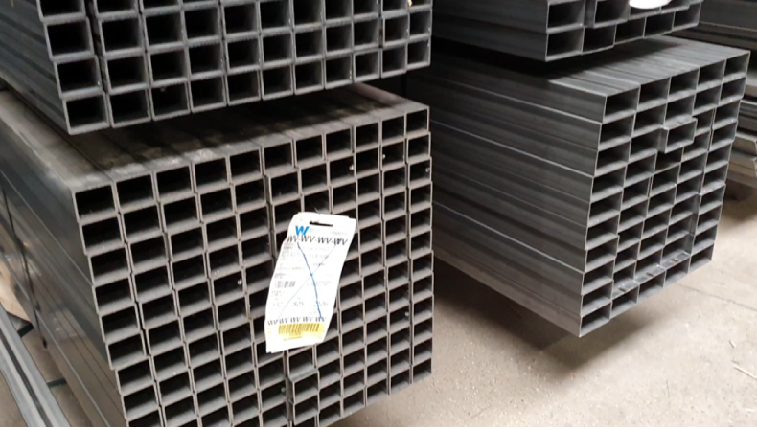
For 95% Bax Metaal processes stainless steel.
Most common sorts are 304 and 316 of which 316 is more corrosion resistant. Both are non-magnetic.
Sheet sizes that are used at Bax Metaal are:
4000x2000
3000x1500
2500x1250
2000x1000
Thickness ranges from 1 to 30 mm
Notes:
FACILITATOR GUIDANCE:
Time: 2 minutes
11:19 – 11:21
Mathijs:

Slide 9
Why using sheet metal?
More knowledge about applying sheet metal
Low cost price
Freedom in designing shapes by using laser cutting
Relatively thin material
Quick to produce
Stiffness can be achieved over longer lengths by using bending
Notes:
FACILITATOR GUIDANCE:
Time: 10 minutes
11:21 – 11:31
Mathijs:

Slide 10
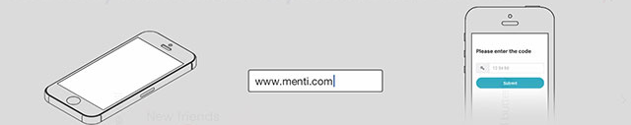
What is the most important reasons to use sheet metal?
Instructions
Instructions
Go to www.menti.com and use code [31 41 03 ]
code 31 41 03
❶ Grab your phone ❷ Go to menti.com ❸ Enter the code
Notes:
FACILITATOR GUIDANCE:
Time: 10 minutes
Remark: check that menti wordclouds, are open for posting
post the wordcloud results in the chat
use arrows to switch between wordclouds. (This will trigger the participants phones to go to the next question)
Tell trainees to click through to the next question
Ask facilitator to voice feedback voice to voice, as you cannot see the conversation
Supporting speaking notes/pointers:
Use a menti wordcloud to capture the arguments, idea is that they also replicate other answers, so that these become bigger.
There are 2 clouds they can post to: first as [manufacturer], second as a [customer support/client]
Then discuss what this means for you as a [designer]

Slide 11
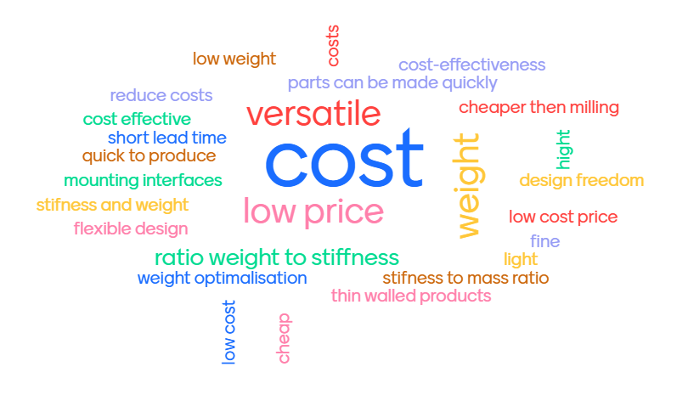
What is the most important reasons to use sheet metal?
Instructions
Notes:
FACILITATOR GUIDANCE:
Time: 10 minutes
Remark: check that menti wordclouds, are open for posting
post the wordcloud results in the chat
use arrows to switch between wordclouds. (This will trigger the participants phones to go to the next question)
Tell trainees to click through to the next question
Ask facilitator to voice feedback voice to voice, as you cannot see the conversation
Supporting speaking notes/pointers:
Use a menti wordcloud to capture the arguments, idea is that they also replicate other answers, so that these become bigger.
There are 2 clouds they can post to: first as [manufacturer], second as a [customer support/client]
Then discuss what this means for you as a [designer]

Slide 12
What are the core process
More knowledge about applying sheet metal
Which processes are needed
Laser cutting general
Laser cutting sheet metal and deburring
Laser cutting tube
Preparation before bending and welding
Bending sheet metal
Welding sheet metal and tube
Aftertreatment – finishing
Cleaning

Slide 13
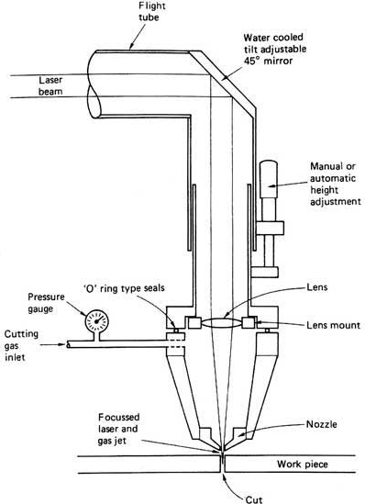
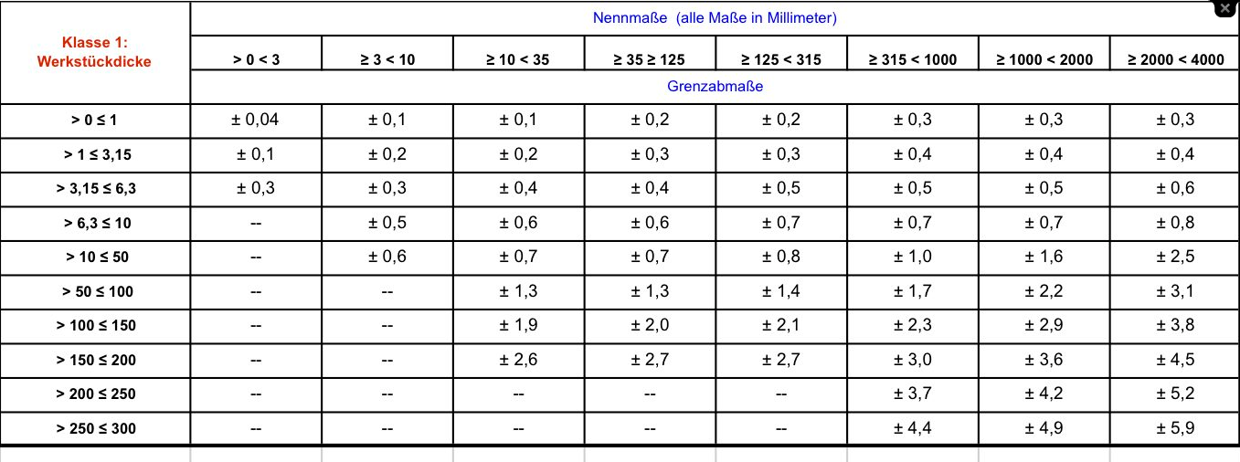
What are the core process
More knowledge about applying sheet metal
Laser cutting general
CO2 laser is used for thicker materials
Fiber laser for thin and different types of material
Speed between 0,5 and 10 m/min
Tolerances according to ISO9013

Slide 14
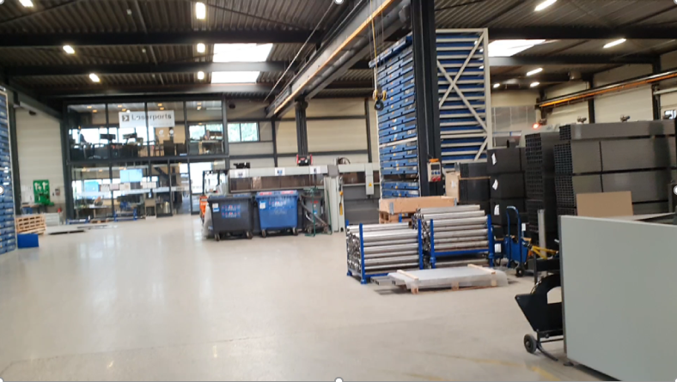
What are the core process
More knowledge about applying sheet metal
Laser cutting sheet metal and deburring

Slide 15
What are the core process
More knowledge about applying sheet metal
Laser cutting tube

Slide 16
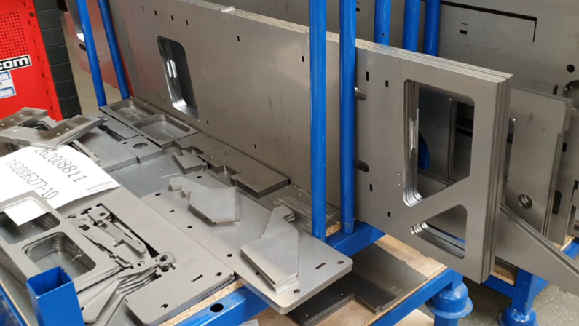
What are the core process
More knowledge about applying sheet metal
Preparation before bending and welding

Slide 17
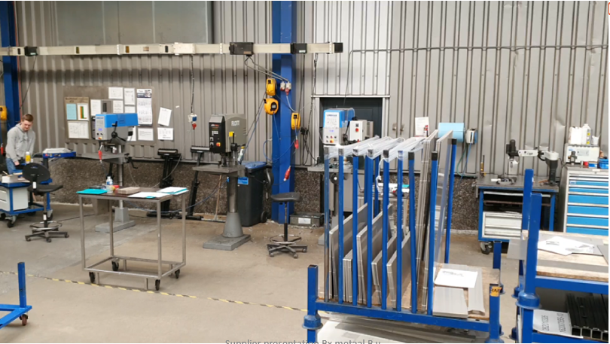
What are the core process
More knowledge about applying sheet metal
Bending sheet metal

Slide 18
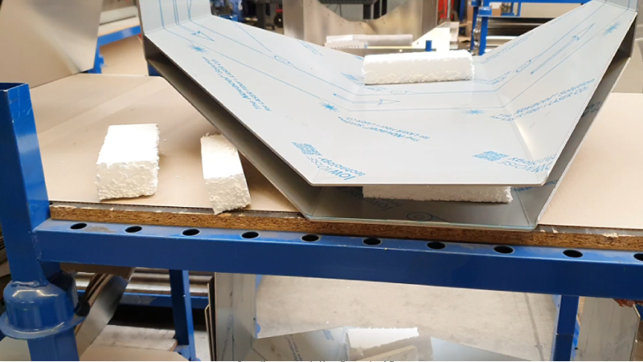
What are the core process
More knowledge about applying sheet metal
Welding sheet metal and tube

Slide 19
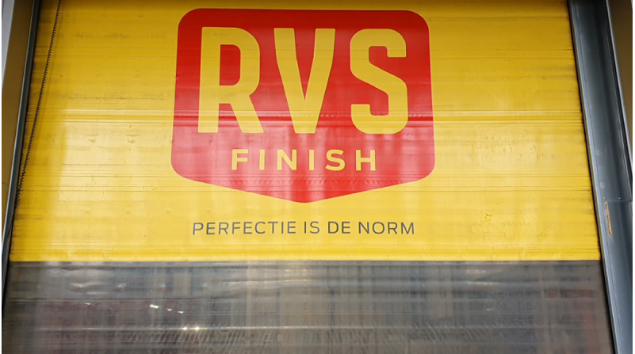
What are the core process
More knowledge about applying sheet metal
Aftertreatment – finishing

Slide 20
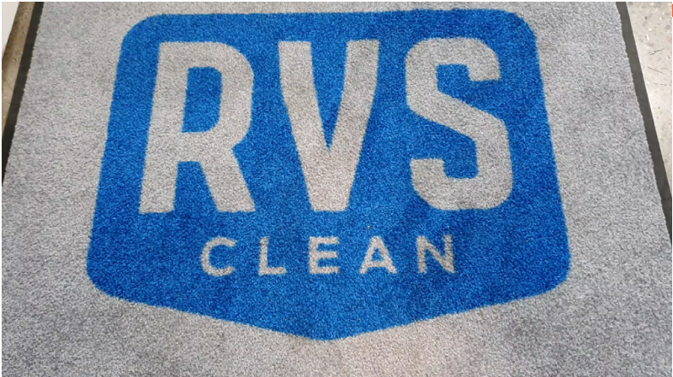
What are the core process
More knowledge about applying sheet metal
Cleaning

Slide 21
Which challenges do you see?
Instructions
“Now you have a better understanding of the possibilities, what challenges do you see in using this technique?”
Instructions
Go to the conversation tab and post your challenges.

Slide 23
How can we cooperate to innovate?
Engineering
Co-engineering.
Collaboration in design process with customer.
If tolerances allowed, sheet metal is great value for money.
Laser cutting and bending are overruled by to narrow tolerances.
Fool proof with male/female connection.
100% offline CAM.
Biggest win is when supplier and customer really work together.

Slide 24
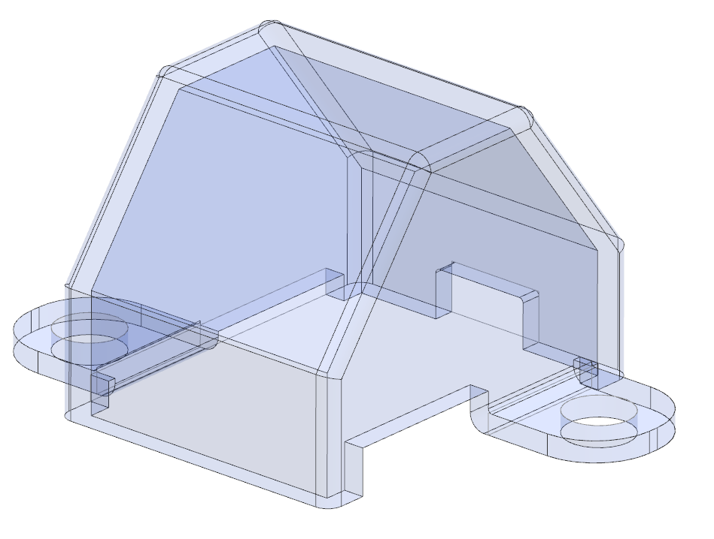
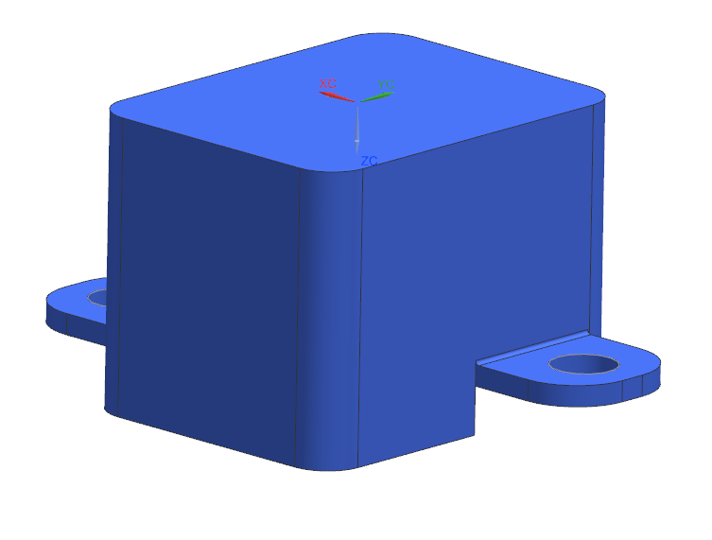
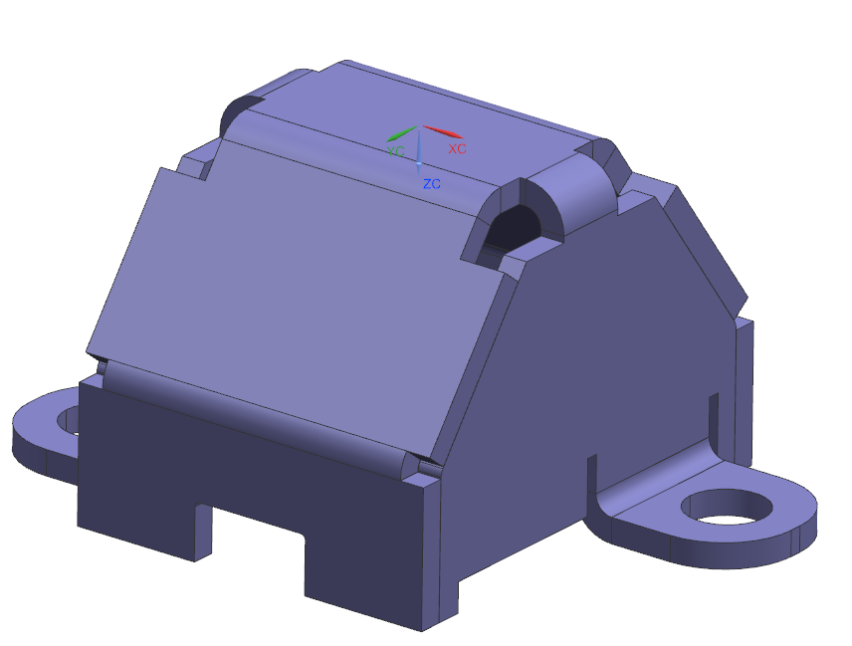
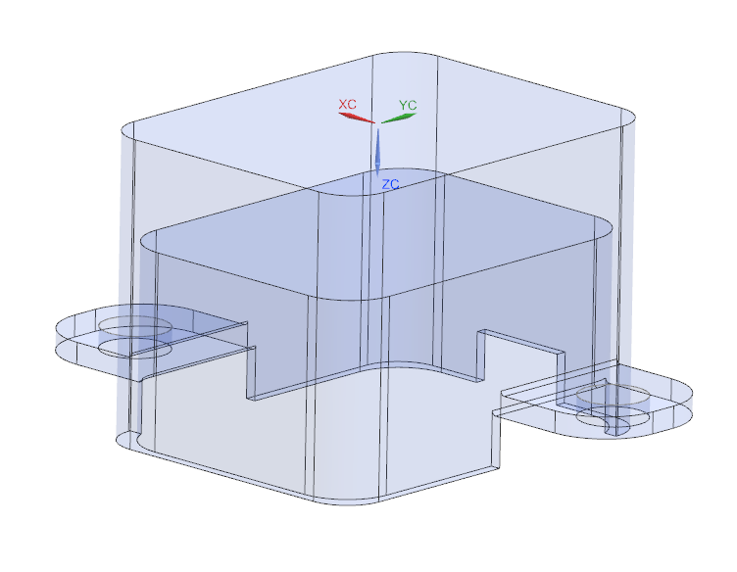
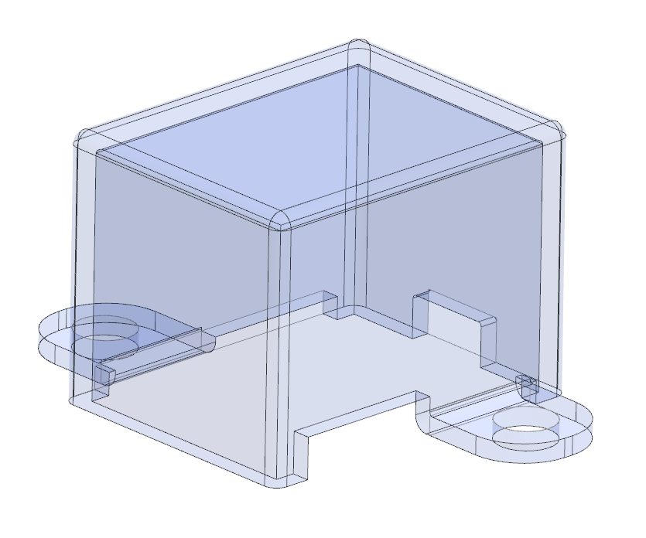
How can we cooperate to innovate?
Engineering
Duration two weeks
Proto parts >> Serie production
ASML starting situation
Bax Metaal B.V. advise
ASML end situation

Slide 25
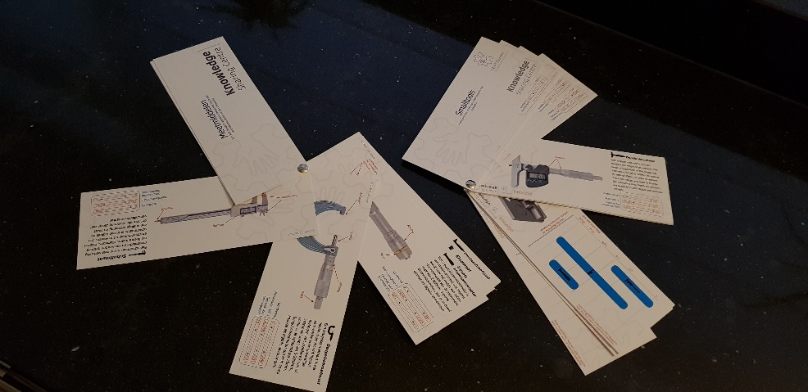
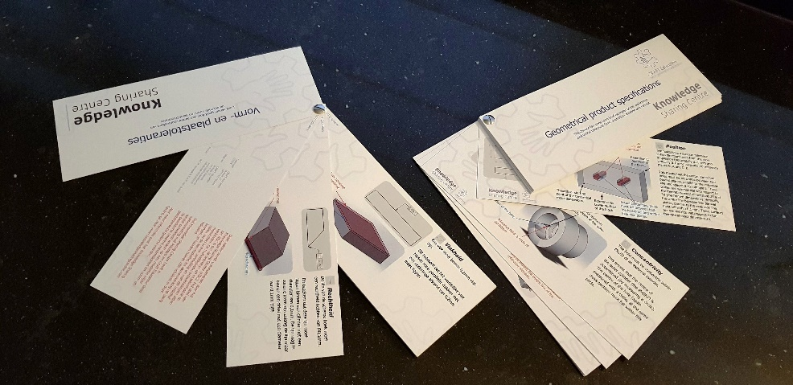
Participate and win.
Questions about sheet metal.
Five inspiration booklets can be won by the first five well-filled questionnaire.
Go to LINK

Slide 26
Participate and win.
Questions about sheet metal.
For the digital version go to.
Dutch LINK
English LINK

Slide 27
How can we cooperate to innovate?
Engineering
Questions:
“We’ve shared our ideas on cooperation, what do you need from us?”
Instructions
Type in conversation tab: Click on the conversation function and share your thoughts.
Answers:
We will look at your comment and will come back on it after this presentation via the question and answers at the Knowledge Sharing Centre platform.
LINK

Slide 28
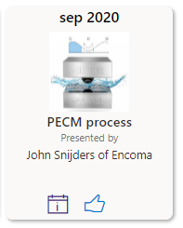
Next Steps
Information
Information about this presentation can be found via this KSC link. >> LINK
It can also be found via the Manufacturing Knowledge SharePoint Link. >> LINK
More questions? Let us know. manufacturing.knowledge.sharing@asml.com
Next presentation? See Manufacturing Knowledge SharePoint. >> LINK
Thank you for participating in this session.
??

