Slide 1
An introduction to ASML’s PMI project
Wim Ottenhoff
January 2018
Version 2.4

Slide 2
Introductie
Wim Ottenhoff
CAD/CAM & PLM Consultant
Settels Savenije PLM Services
Supporting PMI roll-out to suppliers at ASML

Slide 3
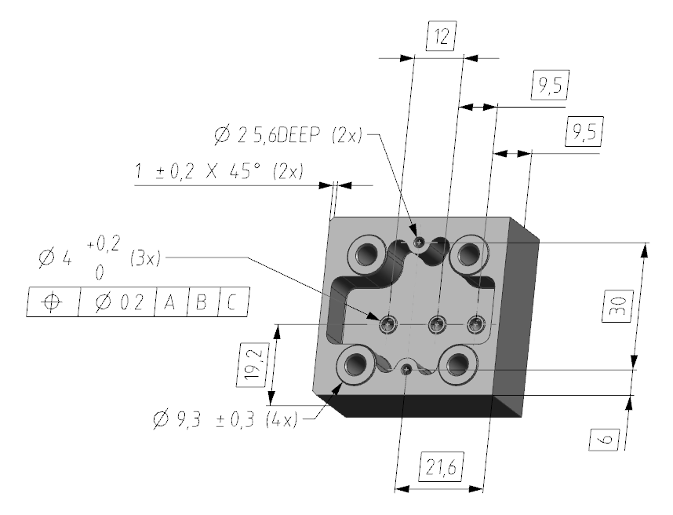
Agenda
Introduction to MBD/PMI
ASML’s MBD/PMI project
Roll out strategy
Questions & discussion

Slide 4
1. Introduction to MBD/PMI

Slide 5
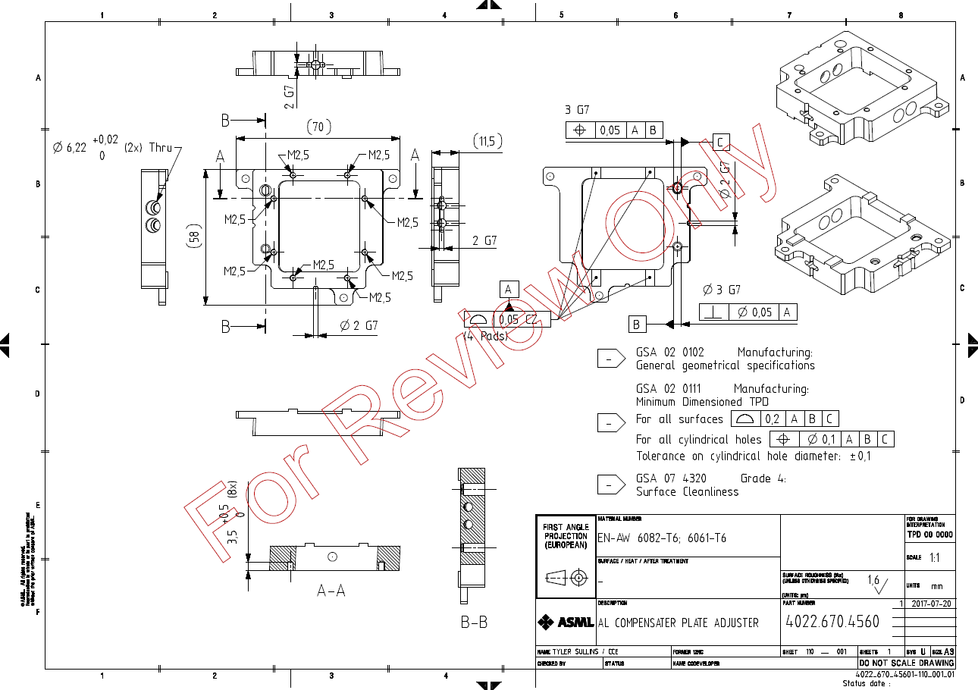
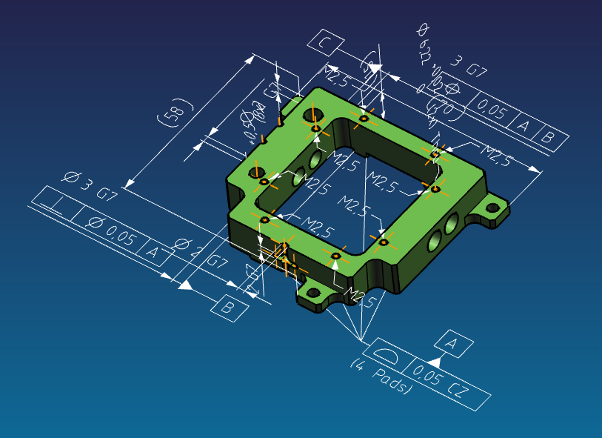
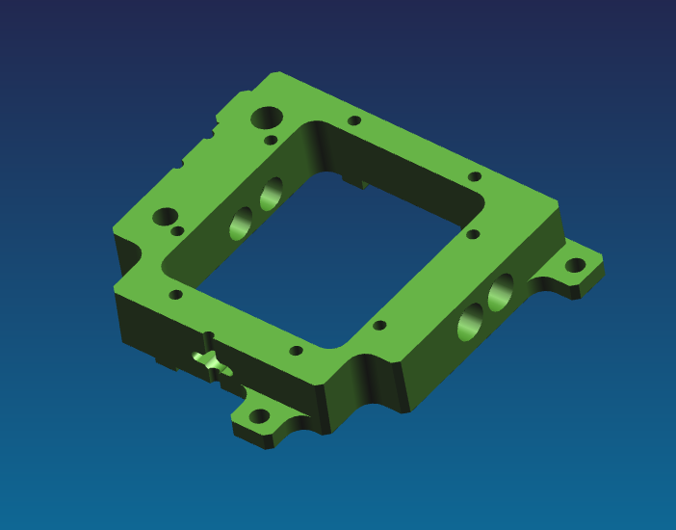
What is MBD/PMI?
+
MBD = Model Based Definition

Slide 6
MBD, PMI, MBE: many abbreviations
MBD = Model Based Definition
Geometric and non geometric information that fully defines a part or assembly
PMI = Product and Manufacturing Information
Non Geometric information that defines a part or assembly
MBE = Model Based Enterprise
Company wide strategy where an annotated digital 3D model of a product serves as the authoritative information source for all activities in in it’s lifecycle
MBSE = Model Based Systems Engineering
System engineering initiative to create a digital model of a system that is used by all engineering disciplines and other functional organizations within a company.

Slide 7
MBD = 3D geometry + PMI
PMI is the non-geometric part of MBD
Like dimensions, tolerances, 3D-annotations, surface finish, material
Model Based
Definition
3D CAD
PMI

Slide 8
Why MBD/PMI?
2D Drawings:
is a 2D view on 3D reality
is intended for humans
can lead to misinterpretation
Is often inconsistent with 3D-model
block downstream reuse and automation
PMI is one of the fundaments of the digital enterprise
Industry 4.0: The fourth industrial revolution

Slide 9
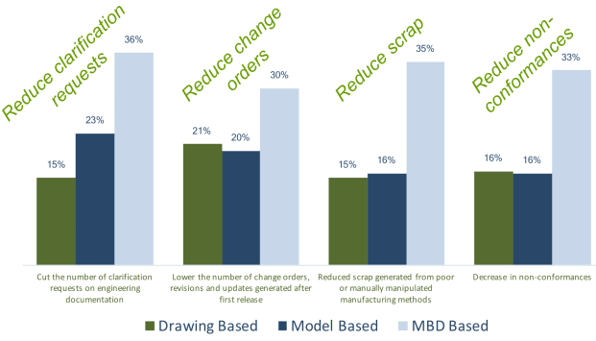
The benefits of MBD/PMI
From report Lifecycle Insights
MBD = “Investing upfront to benefit downstream”

Slide 10
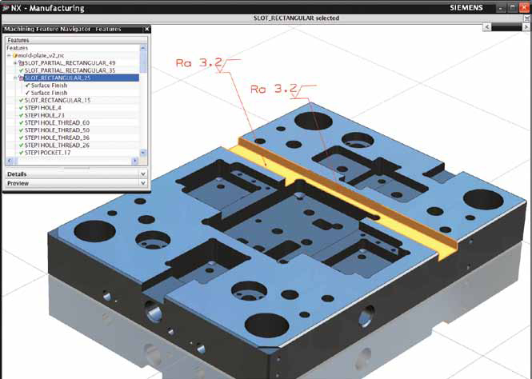
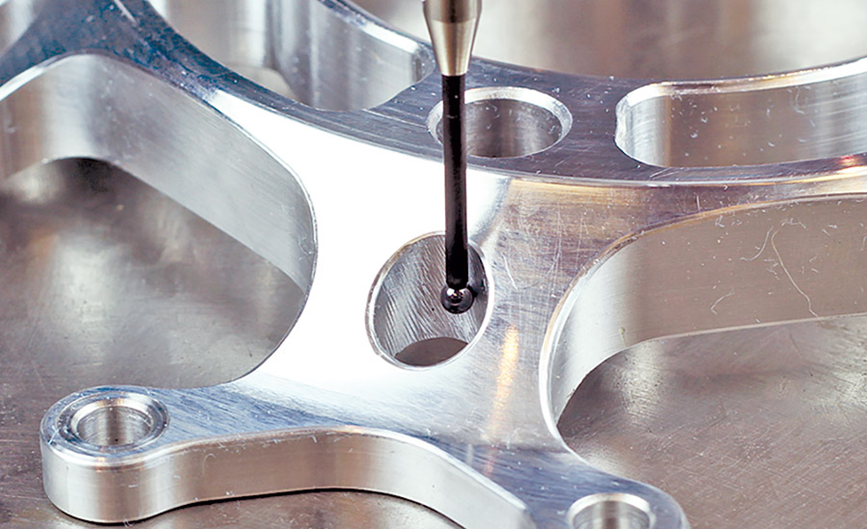
Main benefits of MBD/PMI are in downstream reuse
Reuse in design: clearance analyses
Reuse in CAM: Feature Based Machining
Reuse in First Article Inspection
Reuse in inspection: CMM Programming

Slide 11
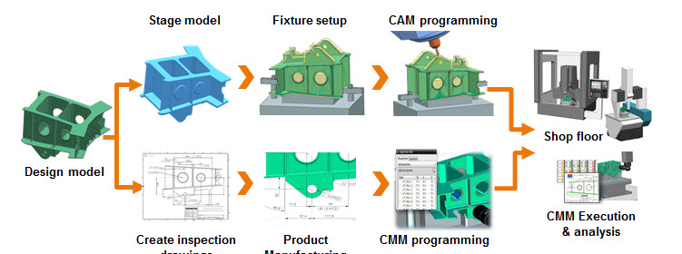
Integrated approach required!
Integrating Engineering - Manufacturing - Inspection
Product Data Management required

Slide 12
Status of MBD/PMI in the industry
Industry
US department of defence and aerospace use MBD
Other industries are introducing MBD
CAD/CAM vendors
All main CAD/CAM vendors support MBD
Reuse of PMI in CAM and CMM is limited yet
STEP242 supports exchange of CAD-data with PMI

Slide 13
Standards related to MBD/PMI
ASME Y14.41 (2012) Digital Product Definition Data Practices
ISO-16792 (2006) ISO variant of the ASME standard
ASME Y14.5 (2009) Standards for GD&T
ISO 1101 (2004) Geometrical Boundaries
STEP AP242 Managed Model Based 3D Engineering (2014)
MIL-STD-31000 (2013) US DoD requirements of Technical Data Packages
ISO 14306 (2012) JT file format specification for 3D visualization
ANSI QIF 2.1 – 2016 Quality Information Framework

Slide 14
2. ASML’s MBD/PMI project

Slide 15
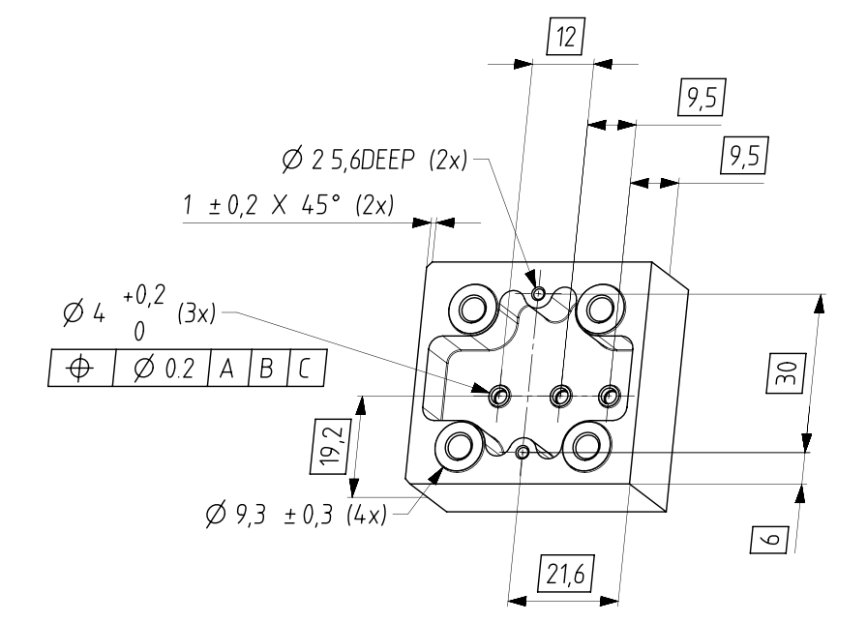
Why ASML introduces MBD/PMI
ASML sees MBD/PMI as opportunity for the supply chain:
To reduce lead time
To reduce cost
To improve quality
From 2018 MBD/PMI TPD will be the standard for new designs
Focus on mono parts

Slide 16
How does MBD/PMI impact ASML’s suppliers?
Phase I – Learn and get used to it
Working without drawings
Little investments (PMI viewers) and limited benefits yet
Phase II – Benefit from it
Re-use in CMM, CAM, inspection, work instructions, …
Requires investments and implementation effort
Benefits are potentially huge!
Main challenge is replacing the paper based way-of-working!
MBD = “Investing upfront to benefit downstream”

Slide 17
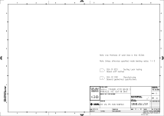
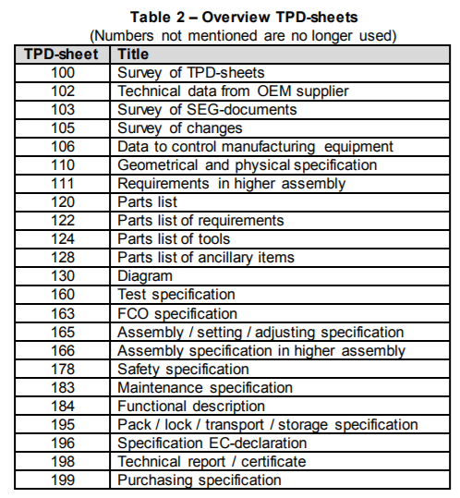
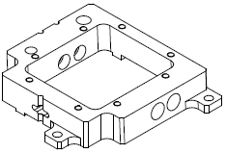
What will change for the supplier
TPD Package (current)
PMI TPD package (to be)
3D model
STEP214 file
3D model with PMI
NX.prt (secure)
STEP AP242 file
JT viewer
TPD 110 sheet (pdf)
2D mdTPD drawing
GSA list, notes, metadata
Title block info
3D ISO view
PMI TPD 110 sheet (pdf) ’container’ for:
3D JT file (viewing)
GSA list, notes, metadata
Title block info
3D ISO view
MD TPD GSA
PMI TPD GSA
Other TPD info doc’s
Other TPD info doc’s

Slide 18
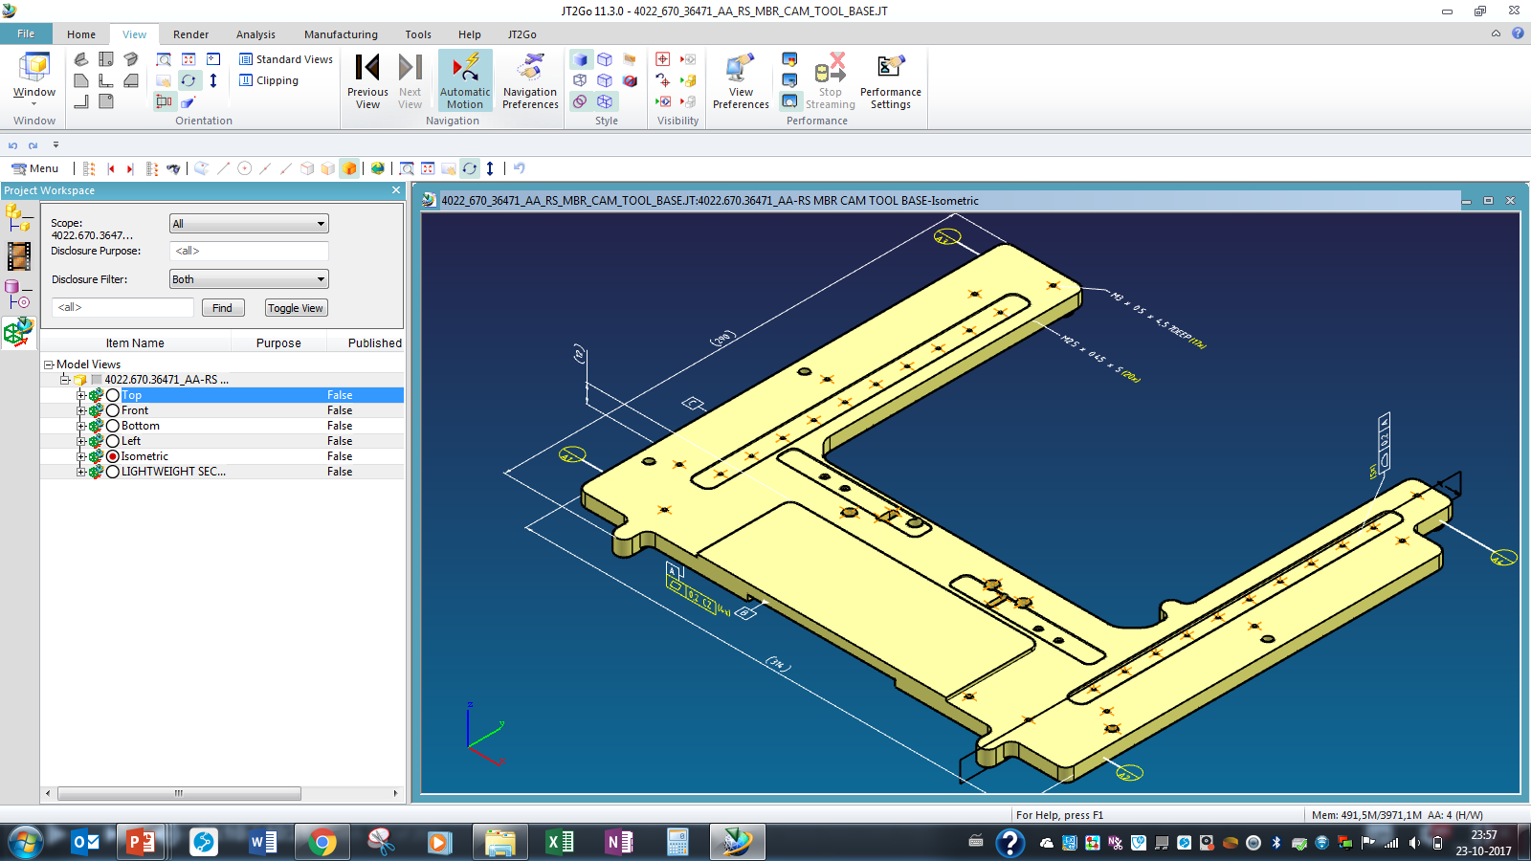
JT2GO: the free viewer for MBD/PMI information

Slide 19
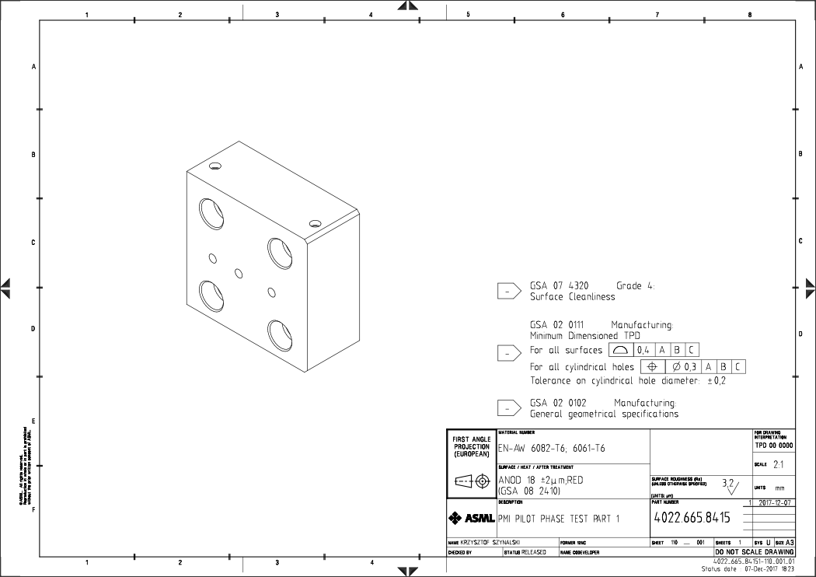
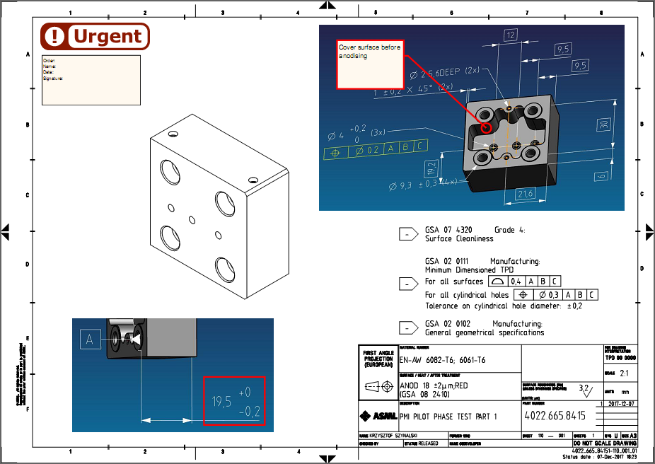
When you need something on paper
PDF editor tools enable to add annotations to the cover sheet such as:
Notes
Stamps
Checklists
Signatures
Etc...
‘Drawingless is not paperless’

Slide 20
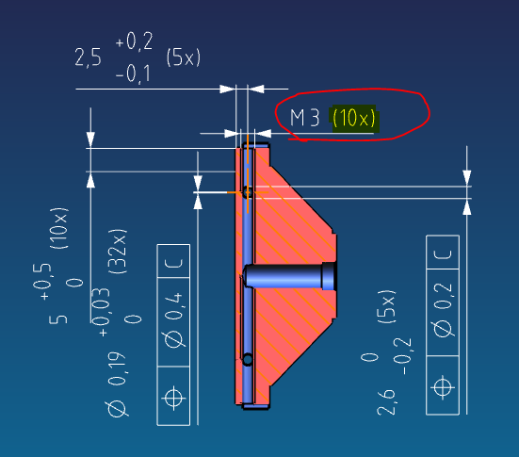
Impact on change management
Review and change process in general remains unchanged
WoW need to be adapted to the new MBD/PMI TPD sets
Feedback from ‘early adopter group’ will be included
Must be (8x)

Slide 21
How to get started with MBD/PMI
Phase I – Learn and get used to it
Install JT2GO-viewers for access to PMI
Investigate impact on current way-of-working
Inform and train all involved
Share experiences with ASML
Phase II – Benefit from it
Investigate if CAD/CAM-applications are ‘MBD-ready’
Explore MBD/PMI opportunities and prioritize them
Make implementation roadmap
Implement, learn and benefit
from quote …
… to delivery
part

Slide 22
3. Roll out strategy

Slide 23
Roll out strategy to suppliers
Step 1
Step 2
Step 3
Inform and challenge
Mutual agreement on MBD/PMI roadmap
Develop and execute MBD/PMI implementation

Slide 24
Objective and timeline
Objective
From 2018 MBD/PMI TPD will be the standard for new designs
Timeline
2017 Q4 : Early supplier involvement
2018 Q1 : Phase I – Able to work with MBD/PMI TPD
2018 Q2 on : Phase II – Implement downstream reuse
2019 onwards : MBD/PMI is common way-of-working

Slide 25
Question & answer

